Slide 1

Automated Task Assignment system
Sue Byeon
Dec. 2, 2025
Notes:
30 sec – introduction
Hello good morning good afternoon and good evening! thank you everyone for joining me here today for my final capstone presentation. My name is Sue Byeon. I am the lead project manager, developer, analyst on this project. I am excited to share with you guys what Ive been working on over the past 10 weeks: an automated task assignment algorithm specifically for the telecom industry. What makes this project unique is that it focuses on matching tasks to technicians based on their individual strengths and capabilities.
So now Lets get into it!

Slide 2
Problem Statement
Misaligned Technician Assignments
Lost Trust & Dissatisfaction
Advanced Network Technology
Losing $2.09 billion/year from churn*
Customers rely on fast, reliable connections for work, school, and social life.
Great Product, Poor Experience
* For a company with 100,000 customers, 30% annual churn rate, and ARPU of $69,690
Notes:
1 min
Now, let’s talk about why this project matters.
In today’s world, people have an undeniable desire to stay connected. Telecom companies play a huge role in this by providing the high-speed connectivity we all depend on for work, school, and staying in touch with friends and family. But here’s the challenge—while customers expect fast and reliable connections, many providers struggle to offer that same quality when it comes to their field services. The main reason? They’re often stuck using outdated task assignment systems.
So, even if you have a great product, you can end up delivering a poor experience to your customers.
To put this into perspective, imagine a company with 100,000 customers. If they have a 30% annual churn rate and an average revenue per user of $70K, that company could lose around $2.09 billion each year—simply because customers are dissatisfied with poor service.

Slide 3
Current State Analysis & Metrics
Task request
Dispatcher assigns manually
Relies on availability or location only
Frequent mismatches
Task execution
Outcome
Customer frustration
Technician frustration & burnout
Customer schedules technician service requests
Technician assigned randomly
58%
Expertise Match Rate
58%
Task Completion Rate
$16.8K
Total Penalty Cost for Delays
3.06
Customer Satisfaction Score
Notes:
1.5 min
In fact, let me show you what the current scheduling process actually looks like, and why it’s creating real inefficiencies across the operation.
Right now, dispatchers assign tasks manually. They usually go by whoever’s available or closest to the job—not necessarily by who has the right skills or expertise. As a result, only about 58% of incoming tasks actually get matched to a technician who’s fully qualified for that job.
This mismatch has a direct impact on our results. When technicians are assigned tasks outside their skill set, our first-time completion rate drops to just 58%. In other words, more than 4 out of 10 tasks require a second visit, which increases the workload and throws off the daily schedule.
There’s also a clear financial cost. So far, the business has taken on about $17,000 in penalty costs just because of rework. Every failed job means dispatching another technician, which adds extra labor, travel, and customer follow-up expenses.
From the technician’s perspective, it’s frustrating—they’re often given tasks they aren’t fully prepared for, which can really hurt morale. And customers are feeling it too. Our current customer satisfaction score averages just 3.06 out of 5, so we know the experience is already being impacted.
So, that’s where we’re starting: a manual assignment process, low match accuracy, high rework, and added pressure on the business, our employees, and our customers.

Slide 4
Risks of Inaction
Financial
Rework costs from failed assignments
Revenue loss due to missed SLAs and churn from dissatisfied customers
Operational
Inefficient scheduling → technician idle time and misallocations
Increased turnover and burnout
Decline in customer trust and satisfaction scores
Risk of negative reviews, regulatory scrutiny, or union action
Inability to scale and lose industry competitiveness
Stagnant service capacity
Reputational
Notes:
1 min – why it matters
So, now that we’ve seen where things stand today, the bigger question is: what happens if we don’t make any changes?
The risks actually pile up in three major areas—financial, operational, and reputational.
Let’s start with the financial impact. If we keep things as they are, the organization will keep absorbing costs from rework. Every time a job isn’t done right the first time, it means sending out another truck, spending more on labor, and sometimes even paying overtime. Plus, when we miss service level agreements and customers aren’t happy, that translates directly into lost revenue. Over time, we also miss out on chances to scale the business efficiently, which means losing out to competitors and passing up market opportunities.
Operationally, the scheduling process stays inefficient. Tasks will continue to land with the wrong technicians, so some people end up overloaded while others are left waiting around. That kind of imbalance leads to burnout and higher turnover—which comes with its own costs when you factor in hiring and training new staff. And with limited capacity, it becomes harder for the organization to grow without sacrificing service quality.
Finally, there’s reputational risk. Customer satisfaction is already under strain, and if things don’t improve, we risk eroding trust even further. That can lead to negative reviews, loss of customer loyalty, and in some cases, even regulatory attention or union concerns if working conditions aren’t addressed.
So, the risk of doing nothing isn’t just about staying where we are—it actually means letting these financial, operational, and reputational problems grow bigger over time.

Slide 5
Technical Solution Overview
Automated Task Assignment System
Improved UI
Automation
Robust Database & Pipeline
ML Matching Algorithm
Faster & Smarter Decisions on Assigning Technicians
Notes:
30 sec
So, how do we tackle these challenges? The solution I’m proposing is an automated task assignment system designed to boost accuracy, efficiency, and the overall quality of service.
Here’s how it works:
First, we start with a solid foundation—a robust database and data pipeline. This setup continuously brings in clean, organized data about both tasks and technicians. That way, the system always has up-to-date, reliable information to make decisions.
Next, at the heart of the solution is a machine learning matching algorithm. This model looks at things like past performance, technician expertise, and the specific details of each task to predict which technician is the best fit for the job. So, instead of relying on gut instinct or manual assignments, we’re making data-driven decisions.
We’ve also completely redesigned the user interface to make it more intuitive for both dispatchers and field teams. It’s now easier to see which technicians are available, review any unassigned tasks, and even understand why the system is recommending certain matches.
And finally, automation steps in. Rather than dispatchers having to scroll through endless lists, the system can instantly recommend—or even automatically assign—the right technician for each job in real time. This cuts down decision-making time, reduces errors, and keeps jobs moving forward without unnecessary delays.
When you put all these pieces together, the result is clear: faster, smarter technician assignments that set us up for success.

Slide 6
Data overview
historical_tasks
Task ID (PK)
Technician ID (FK)
Task Distance
Task Priority
Task Complexity
Equipment Required
Customer Rating
Penalty Cost
Expertise Match
Task Completed
N
N
unassigned_tasks
Task ID (PK)
Task Distance
Task Priority
Task Complexity
Equipment Required
Customer Rating
Penalty Cost
Worked
Assign
1
1
technicians
Technician ID (PK)
Eqpt Trained
Tech Complexity
Notes:
1 min
Let me walk you through how I got started with the data.
I began with two datasets that I sourced from Kaggle. The first one covered task assignments and completion records for field technicians—basically, each row represented a unique task, along with details about the task and how well it matched the technician’s skills. The second dataset focused on completed assignments and their outcomes, including details like operational logistics, what each task required, and how customers rated the results.
To make sense of all this raw data, I transformed everything into a clean, organized structure with three key tables: Technicians, Historical Tasks, and Unassigned Tasks, which you can see in the ERD. Each technician can be linked to multiple completed or incoming tasks—so one technician might have worked on several jobs and could be assigned to many more. This setup lets us connect someone’s past performance directly to their future assignments, and it keeps the data organized for predictive modeling.
I also want to highlight a few key fields that I engineered for this project—like Penalty Cost and Expertise Match on historical_tasks table and Eqpt Trained and Tech Complexity in technicians table. These new features became important drivers for the model. The original datasets lacked broader context of the technician’s skills and distinct factors to merge on. Without those, it would have been hard for the model to really understand the real-world relationships at play.
By creating these engineered fields, I was able to give the model more meaningful information to work with, which laid a strong foundation for the predictive work that comes next.

Slide 7

Data Preparation
Feature Engineering
Are you QUALIFIED or not?
Assumption: Expertise Match looks at equipment requirement and complexity level
Expertise Match + Eqpt Required + Task Complexity
Create Eqpt Trained + Tech Complexity
Recalibrate Expertise Match
Join
Imputation
Task Complexity
Penalty Cost
Eqpt Required
Customer Rating
Based on Task Priority
Notes:
1 min
“For the data preparation phase, I focused on three major steps to get the datasets ready for modeling: joining the tables, imputing missing values, and engineering new features.
First, joining the datasets:
The two original Kaggle tables each captured different parts of the story. One focused on technician task assignments, while the other detailed completed task outcomes. To give the model a fuller picture, I merged them using shared fields—specifically task priority and distance to task—which allowed me to bring in important fields like task complexity, equipment required, and customer rating that weren’t available in both tables.
Second, imputation:
One key variable—Penalty Cost—was missing entirely from the historical tasks table, but it’s important for understanding technician performance and the business impact of delays. The dataset description notes that penalty cost is calculated based on task priority, and during exploratory analysis I found consistent value ranges for each priority level. Using those patterns, I reconstructed penalty cost values so the model could learn from realistic performance signals.
And finally, feature engineering.
Both datasets lacked context around technician skill levels, so I created two new fields: Equipment Trained and Technician Complexity. These helped me reinterpret the original Expertise Match field. The new logic evaluates whether a technician is actually qualified for a task by looking at what equipment the task requires and whether the task’s complexity aligns with the technician’s demonstrated ability. That was the assumption we needed to make about what Expertise Match was supposed to represent. Once that logic was defined, I recalibrated the original Expertise Match column to keep everything consistent.
Essentially, what we’re trying to understand is: based on the types of tasks a technician has successfully completed in the past, what does that say about their skillset?
This step was important because it adds real-world intelligence into the dataset—allowing the model to understand not just what was assigned before, but why certain assignments succeeded or failed.”

Slide 8

Modeling approach
TRAIN/TEST XGBOOST CLASSIFIER MODEL
Task Attributes & Tech Stats
ROC: 0.667
Accuracy: 83.3%
PREDICT
Each tech-task pair
Predict possibility of completing the task
PICK BEST TECH
Soft max
Fair distribution of tech assignments
Target Variable: Task Completed
Who has the best chance of completing the task?
Notes:
1 min
“For the modeling approach, the main question we wanted to answer was: Who has the best chance of successfully completing this task?
To get there, the workflow is built into three cascading steps—train the model, generate predictions, and select the best technician. Starting with training the model: I used an XGBoost classifier, with the feature inputs combining task attributes—such as priority, complexity, and equipment requirements—and technician stats, like whether they are eqpt trained and average customer rating from previous tasks.
The target variable was simply whether the task was completed or not.
The model was trained on an 80/20 train–test split, and it delivered an ROC-AUC of 0.667 and an accuracy of 83.3%, which indicates that the model is moderately good at distinguishing successful versus unsuccessful assignments, while maintaining a strong overall correctness rate.
Once the model was trained, we applied it to every possible technician–task pair.
That means for each unassigned task, the model predicts the probability that each technician would successfully complete it.
And finally, to make the assignment decision, I used a softmax-based approach.
This takes all the predicted probabilities for a task and turns them into weighted random choices. The benefit here is that the highest-probability technician is still the most likely to be selected, but we avoid systematic bias toward technicians who tend to score higher across the board. It keeps the process fair and balanced.
Overall, this framework lets us compare technicians in a consistent, data-driven way and assign each task to the individual with the strongest likelihood of success.”

Slide 9
Application Demo
Python Transformation
Frontend: React
Backend: FastAPI
Notes:
3 min
“Now that we’ve covered how the model makes predictions, I want to show how the entire system comes together in practice.
The application runs on a FastAPI backend, which does all the heavy lifting. It serves the machine-learning model, manages the data flow, and handles all the Python-based transformations behind the scenes.
On the front end, I built a React interface that gives users a clean, intuitive way to interact with the system and request technician assignments in real time.
These two layers connect through a fully API-driven architecture, so every prediction, task update, and technician detail moves smoothly between the backend and the user interface.
With that foundation in place, let me walk you through what the system actually looks like
12. Application Demo (Screenshots or Live Demo)
Homepage
Technician profile
Unassigned tasks list
Automated assignment workflow
“Assigned” confirmation and logs

Slide 10
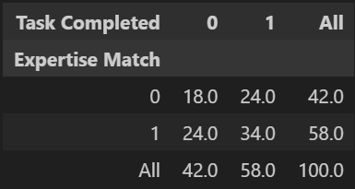
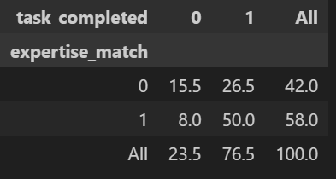
Operational results & impact
BEFORE:
58%
Expertise Match Rate
58% → 76.5%
Task Completion Rate
AFTER:
Faster Job Turnaround
Fewer Errors
More Efficient Use of Workforce
Notes:
“Now that you’ve seen how the system actually works end-to-end, here is what this new process delivers in practice.
To evaluate impact, I broke the results into three areas that matter most to the business: operational performance, financial efficiency, and company reputation.
“Operationally, the system drove a significant performance lift. Our overall task completion rate increased by 32%, rising from 58% to 76.5%. That improvement directly reflects the model’s ability to assign the right technician to the right job.
Now, the expertise match rate itself remained at 58%, but the quality of those matches improved dramatically. If you look at the tables here, When a technician was matched on expertise, they were far more likely to complete the task successfully. And when expertise was missing, the system exposed those mismatches more clearly.
Together, this means faster job turnaround, fewer errors, and a much more efficient use of our field workforce.”

Slide 11
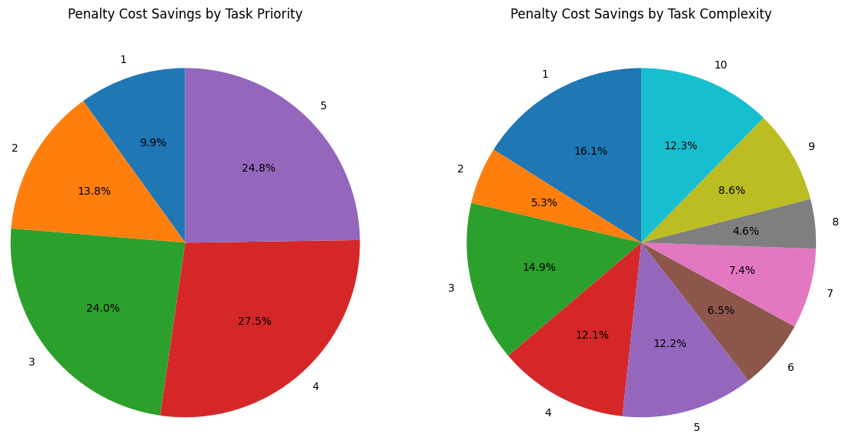
Financial Results & impact
$12.7K
Penalty Cost Savings
Avoid Rework + SLA Penalties
More Efficient Technician Time
Higher Service Margins
Notes:
“One of the clearest indicators of improvement is penalty cost. Today, the organization incurs about $16.8K in avoidable penalties due to misassignments and rework.
With the optimized matching model, that number drops to $4.1K — a reduction of $12.7K, or about 76%. This improvement is driven largely by better completion of urgent, high-priority tasks from the looks of the pie graphs— the tasks that carry the highest financial risk when they fail. The financial impact shows up in three ways: First, we avoid expensive rework — fewer repeat truck rolls, less overtime, and fewer SLA violations. Second, technicians spend less time fixing failed jobs and more time completing billable work. And third, margins improve because the costliest tasks are being done correctly the first time. Altogether, this reduction in penalty cost directly boosts operational efficiency and bottom-line profitability

Slide 12
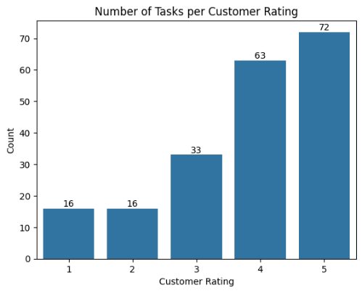
Reputational results & impact
20%
Customer Satisfaction Score
Enhance Reputation
Increases Customer Retention
Become More Competitive
Notes:
“From a reputational standpoint, we also saw a clear improvement in customer experience. The average customer rating increased by 20%, reaching 3.66, and the bar chart shows a noticeable left-skew, meaning more customers are giving higher scores after implementation.
This shift reflects stronger confidence in service quality and a more consistent experience in the field. Higher satisfaction not only strengthens the company’s public reputation but also improves customer retention — which is critical in a telecom market where reliability is a major differentiator.
Overall, the system doesn’t just make operations and finances better — it meaningfully improves how customers feel about the service they receive.”

Slide 13
Limitations & future work
Collect More Data
Response to Real-Time Disruptions
Route Optimization
Small Dataset
Missing Contextual Data
Challenges with Derived Attributes
Notes:
1 min
“As strong as these results are, it’s also important to look at the limitations and where this system can go next.
The biggest challenge was the size of the training dataset. With so few records, the model could only learn a narrow range of patterns, which increases the chance of overfitting and limits how well it can generalize to new or unusual tasks.
Another limitation was the lack of contextual depth in the Kaggle datasets. Key operational information—like technician certifications, task categories, route constraints, or work history—simply wasn’t there. Because of that, a lot of the engineered fields, like technician complexity and equipment training, had to be inferred based on assumptions rather than true behavioral data. That allowed the model to function, but it also introduced uncertainty and made those columns less precise than they would be with real-world context.
Looking ahead, expanding data collection is the single biggest opportunity for improvement. Pulling data directly from the live service platform would allow us to build richer technician profiles, more accurate task attributes, and a far more robust training set.
There’s also room to explore how the model responds to real-time disruptions—things like sudden outages, high-volume spikes, or when a technician unexpectedly becomes unavailable. This could give very practical operational value.
And finally, integrating route optimization would push the system closer to real scheduling intelligence. Adding travel times, geographic constraints, and technician proximity would not only improve assignment accuracy but also reduce idle time and speed up service delivery.
So while the current model performs well within the constraints of the dataset, there is a clear path to making it smarter, more flexible, and much more aligned with real-world field operations.”

Slide 14
Business recommendations
Change Management Plan
Employee Trainings
Notes:
30 sec
To fully realize that value, I recommend a structured rollout: start with a pilot region, pair it with hands-on technician training focused on interpreting assignments and understanding expertise logic, and trainings for supervisors to learn about to use the tool from the UI. Change management should include clear communication on why the system is being adopted, simple job aids, and ongoing feedback loops so both technicians and supervisors can shape how the tool evolves.
With these steps in place, this solution can become a new benchmark for operational efficiency, reliability, and customer satisfaction—turning data insights into meaningful business impact.
And this concludes the presentation. Thank you all for listening.”

